Slide 1
Android Platform Overview (1)
Notes:
1

Slide 2
Android
A S/W stack for mobile devices developed and managed by OHA
A free S/W under Apache License
Android
Key Applications
Middleware
Operating System (Linux Kernel 2.6)
Notes:
2

Slide 3
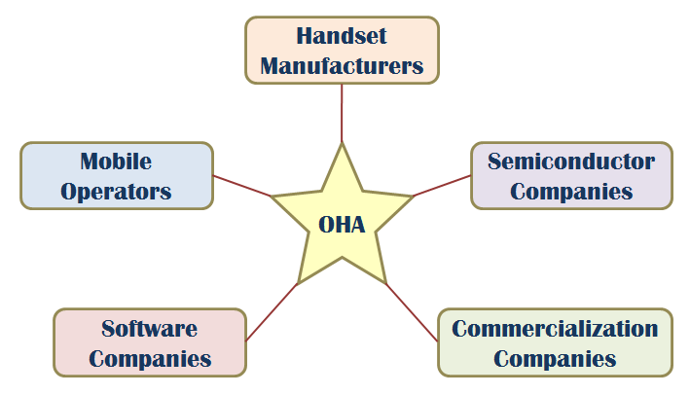
OHA (Open Handset Alliance)
A business alliance consisting of 47 companies to develop open standards for mobile devices

Slide 4
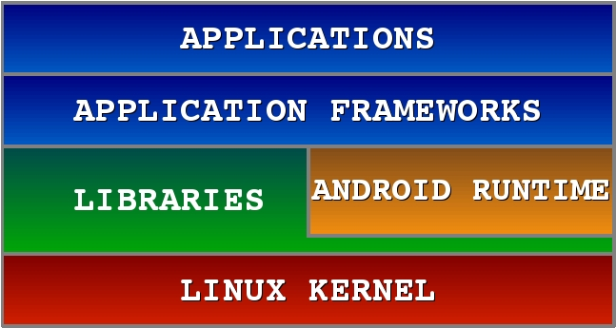
Android Software Stack

Slide 5
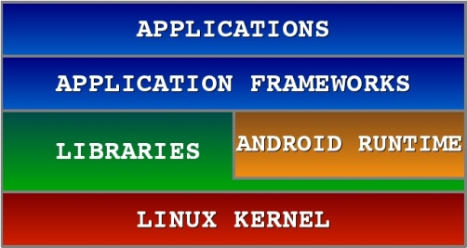
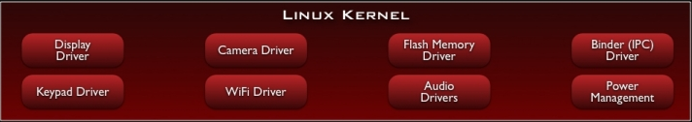
Android S/W Stack – Linux Kernel
Relying on Linux Kernel 2.6 for core system services
  Memory and Process Management
  Network Stack
  Driver Model
  Security
Providing an abstraction layer between the H/W and the rest of
the S/W stack

Slide 6
Android S/W Stack – Linux Kernel (Cont)
Kernel Enhancements
  Alarm
  Ashmem
  Binder
  Power Management
  Low Memory Killer
  Kernel Debugger
  Logger

Slide 7
Android S/W Stack – Linux Kernel (Cont)
Binder
  Driver to facilitate IPC between applications and services
  Problems of Linux IPC
    Applications and Services may run in separate processes but must communicate and share data
    IPC can introduce significant processing overhead and security hole
  Properties of Binder
    High performance through shared memory
    Per-process thread pool for processing requests
    Reference counting and mapping of object references across processes
    Synchronous calls between processes

Slide 8
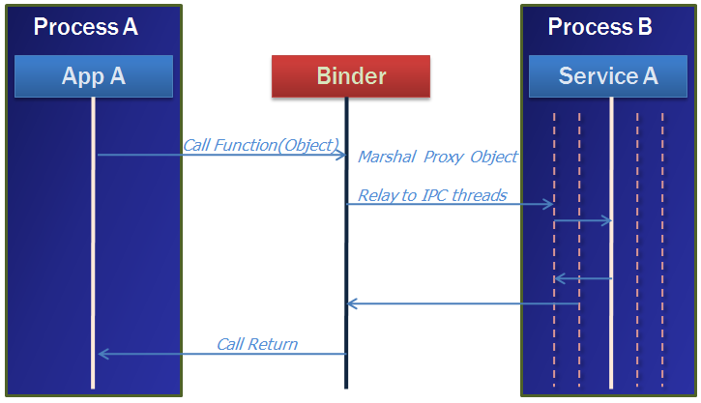
Android S/W Stack – Linux Kernel (Cont)
Binder in Action
  A pool of threads is associated to each service application to process incoming IPC.
  Binder performs mapping of object between two processes.
  Binder uses an object reference as an address in a process’s memory space.

Slide 9
Android S/W Stack – Linux Kernel (Cont)
Power Management
  Problem
    Mobile devices depend on battery power and batteries have limited capacity.
  Properties of Power Management
    PM is built on top of standard Linux Power Management.
    PM supports more aggressive power management policy.
    Components make requests to keep the power on through “Wake Locks”.
    PM supports several different types of wake “Wake Locks”.

Slide 10
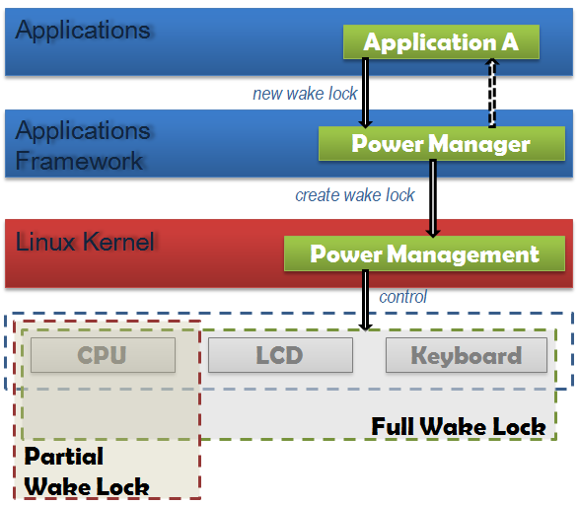
Android S/W Stack – Linux Kernel (Cont)
Power Management in Action
If there are no active wake locks, CPU will be turned off.
If there are no partial wake locks, screen and keyboard will be turned off.

Slide 11
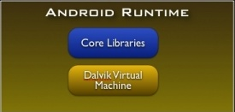
Android S/W Stack - Runtime
Core Libraries
  Providing most of the functionality available in the core libraries of the Java language
  APIs
    Data Structures
    Utilities
    File Access
    Network Access
    Graphics
    Etc

Slide 12
Android S/W Stack – Runtime (Cont)
Dalvik Virtual Machine
  Providing environment on which every Android application runs
    Each Android application runs in its own process, with its own instance of the Dalvik VM.
    Dalvik has been written so that a device can run multiple VMs efficiently.
  Register-based virtual machine

Slide 13
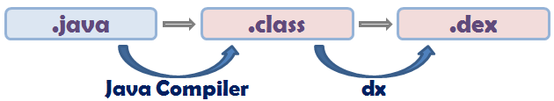
Android S/W Stack – Runtime (Cont)
Dalvik Virtual Machine (Cont)
  Executing the Dalvik Executable (.dex) format
    .dex format is optimized for minimal memory footprint.
    Compilation
  Relying on the Linux Kernel for:
    Threading
    Low-level memory management

Slide 14
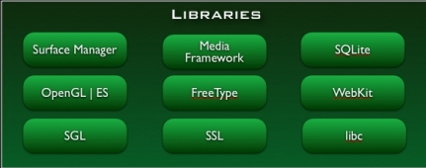
Android S/W Stack - Libraries
Including a set of C/C++ libraries used by components of the Android system
Exposed to developers through the Android application framework

Slide 15
Android S/W Stack – Libraries (Cont)
Features
  System C Library (Bionic)
  Media Libraries
  Surface Manager (Surface Flinger)
  Audio Manager (Audio Flinger)
  LibWebCore (WebKit)
  SGL
  3D Libraries
  FreeType
  SQLite

Slide 16
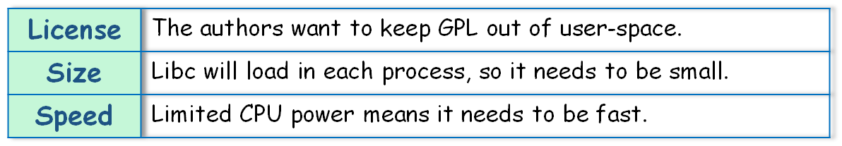
Android S/W Stack – Libraries (Cont)
Bionic
  Custom libc implementation optimized for embedded use
  Problem with GNU libc

Slide 17
Android S/W Stack – Libraries (Cont)
Bionic (Cont)
  Properties
    BSD license
    Small size and fast code paths
    Very fast and small custom pthread implementation
    No support for certain POSIX features
    No compatibility with GNU libc
    Constraint that all native code must be compiled against bionic

Slide 18
Android S/W Stack – Libraries (Cont)
WebKit
  An application framework that provides foundation for building a web browser based on open source WebKit browser
  Properties
    Ability to render pages in full (desktop) view
    Full CSS, JavaScript, DOM, AJAX support
    Support for single-column and adaptive view rendering

Slide 19
Android S/W Stack – Libraries (Cont)
Media Framework
  A media framework based on PacketVideo OpenCore platform
  Properties
    Support for standard video, audio, still-frame formats
    Support for hardware/software codec plug-ins
SQLite
  Light-weight relational database management system
  Back end for most platform data storgae

Slide 20
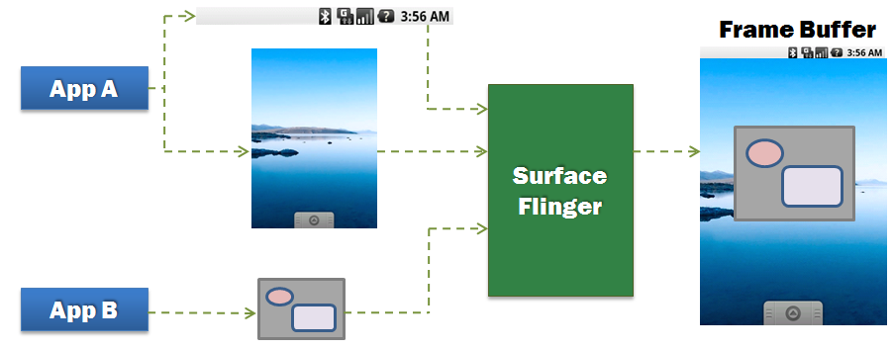
Android S/W Stack – Libraries (Cont)
Surface Manager (Surface Flinger)
  Providing system-wide surface composer, handling all surface rendering to frame buffer device
  Operation

Slide 21
Android S/W Stack – Libraries (Cont)
Surface Manager (Cont)
  Properties
    Can combine 2D and 3D surfaces and surfaces from multiple applications
    Surfaces passed as buffers via Binder IPC calls
    Can use OpenGL ES and 2D hardware accelerator for its compositions
    Double-buffering using page-flip

Slide 22
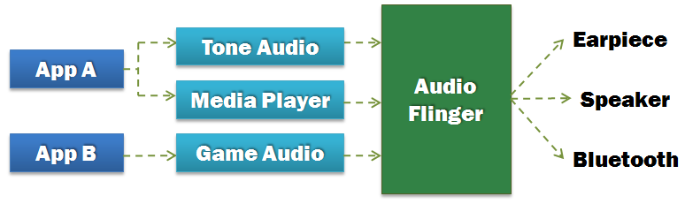
Android S/W Stack – Libraries (Cont)
Audio Manager (Audio Flinger)
  Processing multiple audio streams into PCM audio out paths
  Operation

Slide 23
Android S/W Stack – Libraries (Cont)
SGL
  The underlying 2D graphics engine
3D Libraries
  An implementation based on OpenGL ES 1.0 APIs
  Using either H/W 3D acceleration (if available) or the included optimized 3D S/W rasterizer
FreeType
  Rendering bitmap and vector font

Slide 24
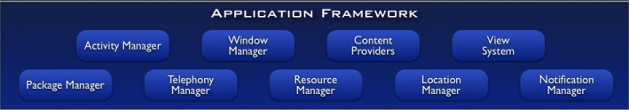
Android S/W Stack – App Framework
Enabling and simplifying the reuse of components
  Developers have full access to the same framework APIs used by the core applications.
  Users are allowed to replace components.

Slide 25
Android S/W Stack – App Framework (Cont)
Features
Feature | Role
View System | Used to build an application, including lists, grids, text boxes, buttons, and embedded web browser
Content Provider | Enabling applications to access data from other applications or to share their own data
Resource Manager | Providing access to non-code resources (localized string , graphics, and layout files)
Notification Manager | Enabling all applications to display customer alerts in the status bar
Activity Manager | Managing the lifecycle of applications and providing a common navigation backstack

Slide 26

Android S/W Stack - Application
Android provides a set of core applications:
  Email Client
  SMS Program
  Calendar
  Maps
  Browser
  Contacts
  Etc
All applications are written using the Java language.

